Slide 1
THEORIES OF COMMUNICATION

Slide 2
1. Shannon-Weaver Model.
Shannon and Weaver produced a general model of communication known after them as the Shannon-Weaver Model. It involved breaking down an information system into sub-systems so as to evaluate the efficiency of various communication channels and codes.

Slide 3
Cont;
They propose that all communication must include six elements:
Source
Encoder
Channel
Message
Decoder
Receiver

Slide 4
Cont;
This model is often referred to as an " information model" of communication. A drawback is that the model looks at communication as a one-way process. That is remedied by the addition of the feedback loop.

Slide 5
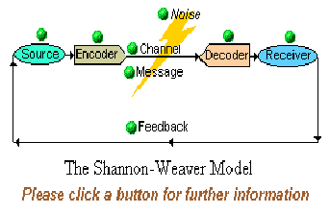
Cont;

Slide 6
2. Berlo's S-M-C-R Model
Berlo"s SMCR (SOURCE, MESSAGE, CHANNEL, and RECEIVER) model focuses on the individual characteristics of communication and stresses the role of the relationship between the source and the receiver as an important variable in the communication process.

Slide 7
Cont;
The more highly developed the communication skills of the source and the receiver, the more effectively the message will be encoded and decoded.

Slide 8
Cont;
Berlo's model represents a communication process that occurs as a SOURCE drafts messages based on one's communication skills, attitudes, knowledge, and social and cultural system. These MESSAGES are transmitted along CHANNELS, which can include sight, hearing, touch, smell, and taste.

Slide 9
Cont;
A RECEIVER interprets messages based on the individual's communication skills, attitudes, knowledge, and social and cultural system. The limitations of the model are its lack of feedback

Slide 10
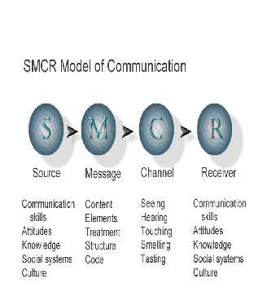

Slide 11
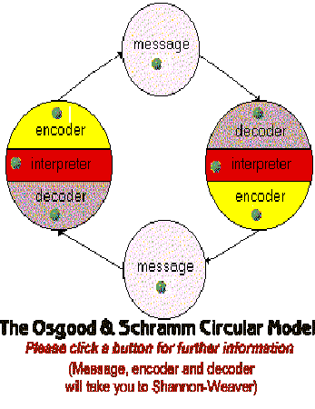
3. The Osgood and Schramm Model

Slide 12
Cont;
It emphasizes the circular nature of communication.
The participants swap between the roles of source/encoder and receiver/decoder.

Slide 13
4.Media Dependency Theory
It was developed by Ball-Rokeach and DeFluer, the key idea behind this theory is that audiences depend on media information to meet needs and reach goals, and social institutions and media systems interact with audiences to create needs, interests, and motives in the person.

Slide 14
Cont;
The degree of dependence is influenced by the number and centrality of information functions and social stability. Some questions that this theory raised were : Do media create needs?

Slide 15
Cont;
Do people turn to media to achieve gratification and satisfy needs? Are media needs personal, social, cultural, political, or all of these? "The media are our friends"??

Slide 16
6.McCombs and Shaw"s agenda setting theory
The theory puts forth the ability of the media to influence the significance of events in the public's mind. The media set the agenda for the audience's discussion and mentally order and organize their world.

Slide 17
7.Consistency theories (1950s)
Festinger formulated the consistency theories that talked about people"s need for consistency in their beliefs and judgements. In order to reduce dissonance created by inconsistencies in belief, judgments and action people expose themselves to information that is consistent with their ideas and actions, and they shut out other communications.

Slide 18
Cont;
The theory is consistent with a "use and gratification" approach. McCombs and Shaw assert that the agenda-setting function of the media causes the correlation between the media and public ordering of priorities.

Slide 19
8.Spiral of Silence theory
Founded by Elisabeth Noelle-Neumann, this theory states that the media publicizes opinions that are mainstream and people adjust their opinions according to their perceptions to avoid being isolated.

Slide 20
Cont;
Individuals who perceive their own opinion as being accepted will express it, whilst those who think themselves as being a minority, suppress their views. Innovators and change agents are unafraid to voice different opinions, as they do not fear isolation.

Slide 21
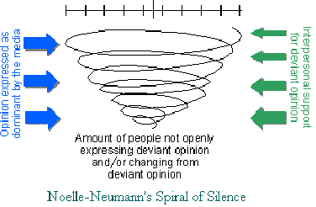

Slide 22
9.Uses and Gratification theory
This theory propounded by Katz in 1970, is concerned with how people use media for gratification of their needs. An outcome of Abraham Maslow's Heirarchy of Needs, it propounds the fact that people choose what they want to see or read and the different media compete to satisfy each individual"s needs.

Slide 23
Cont;
In the hierarchy of needs, there are five levels in the form of a pyramid with the basic needs such as food and clothing at the base and the higher order needs climbing up the pyramid. The fulfillment of each lower level need leads to the individual looking to satisfy the next level of need and so on till he reaches the superior-most need of self-actualization.

